Slide 1
CS 61C: Great Ideas in Computer Architecture Lecture 3: Pointers
Krste Asanović & Randy Katz
http://inst.eecs.berkeley.edu/~cs61c

Slide 2
Agenda
Pointers in C
Arrays in C
This is not on the test
Pointer arithmetic
Strings, main
And in Conclusion, …

Slide 3
Components of a Computer
Processor
Memory
Enable?
Read/Write
Input
Control
Program
Datapath
Address
PC
Bytes
Write Data
Registers
Arithmetic & Logic Unit
(ALU)
Data
ReadData
Output
Processor-Memory Interface
I/O-Memory Interfaces
Notes:
focus memory

Slide 4
Computer Memory
Type | Name | Addr | Value
 |  | …
 |  | 108
 |  | 107
 |  | 106
 |  | 105
 |  | 104
 |  | 103
 |  | 102
 |  | 101
 |  | 100
 |  | …
int a;
a = -85;
printf(“%d”, a);
Do not confuse memory address and value.
Nor a street address with the person living there.
Notes:
Big table of words (e.g. 32 bits each)
Just like houses in a city, each word has an address, e.g. 380 Soda Hall, Berkeley, CA 94720
Computers use numbers as addresses
Note: addresses and values are different
Just like a house is not the same as its address (give me a house or an address?)

Slide 5
Pointers
Type | Name | Addr | Value
 |  | …
 |  | 108
 |  | 107
 |  | 106
 |  | 105
 |  | 104
 |  | 103
 |  | 102
 |  | 101
 |  | 100
 |  | …
C speak for “memory addresses”
Notation
int *x; // variable x is an address to an int
int y = 9; // y is an int
x = &y; // assign address of y to x
// “address operator”
int z = *x; // assign what x is pointing to to z
// “dereference operator”
*x = -7; // assign -7 to what x is pointing to
What are the values of x, y, z?

Slide 6
Pointer Type
Pointers have types, like other variables
“type of object” the pointer is “pointing to”
Examples:
int *pi; // pointer to int
double *pd; // pointer to double
char *pc; // pointer to char

Slide 7
Generic Pointer (void *)
Generic pointer
Points to any object (int, double, …)
Does not “know” type of object it references (e.g. compiler does not know)
Example:
void *vp; // vp holds an address to // object of ”arbitrary” type
Applications
Generic functions e.g. to allocate memory
malloc, free
accept and return pointers of any type
see next lecture

Slide 8
Pointer to struct

Slide 9
Your Turn!
Type | Name | Addr | Value
 |  | …
 |  | 108
 |  | 107
 |  | 106
 |  | 105
 |  | 104
 |  | 103
 |  | 102
 |  | 101
 |  | 100
 |  | …
Answer | a | b
RED | 3 | -7
GREEN | 4 | 5
ORANGE | -4 | 5
YELLOW | -2 | 5

Slide 10
What’s wrong with this Code?
Output:
a = 1853161526,
p = 0x7fff5be57c08,
*p = 0
Notes:
Values of unutilized variables is arbitrary
Output is random, changes between executions (I tried this!)
Worst case: uninitialized pointer “points” to illegal memory address (e.g. 0):
fatal error, overwrite data, code, …
Do not count on *p == 0

Slide 11
Pointers as Function Arguments
Type | Name | Addr | Value
 |  | …
 |  | 108
 |  | 107
 |  | 106
 |  | 105
 |  | 104
 |  | 103
 |  | 102
 |  | 101
 |  | 100
 |  | …
C passes arguments by value
i.e. it passes a copy
value does not change outside function
To pass by reference use a pointer
Notes:
a=1 b=-9

Slide 12
Parameter Passing in Java
“primitive types” (int, char, double)
by value (i.e. passes a copy)
Objects
by reference (i.e. passes a pointer)
Java uses pointers internally
But hides them from the programmer
Mapping of variables to addresses is not defined in Java language
No address operator (&)
Gives JVM flexibility to move stuff around

Slide 13
Your Turn!
Type | Name | Addr | Value
 |  | …
 |  | 105
 |  | 104
 |  | 103
 |  | 102
 |  | 101
 |  | 100
 |  | …
Answer | a | b | c
RED | 5 | 3 | 1
GREEN | 1 | 5 | 3
ORANGE | 3 | 3 | 1
YELLOW | 3 | 5 | 1

Slide 14
Agenda
Pointers in C
Arrays in C
This is not on the test
Pointer arithmetic
Strings, main
And in Conclusion, …

Slide 15
C Arrays
Type | Name | Addr | Value
 |  | …
 |  | 108
 |  | 107
 |  | 106
 |  | 105
 |  | 104
 |  | 103
 |  | 102
 |  | 101
 |  | 100
 |  | …
Declaration:
// allocate space // unknown content int a[5];
// allocate & initialize int b = { 3, 2, 1 };
Element access:
b[1];
a[2] = 7;
Index of first element: 0

Slide 16
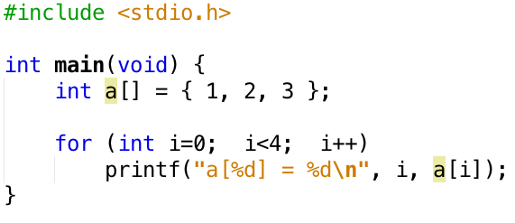
Beware: no array bound checking!
Often the result is much worse:
erratic behavior
segmentation fault, etc.
C does not know array length!
Pass as argument into functions
Output: a[0] = 1
a[1] = 2
a[2] = 3
a[3] = -1870523725

Slide 17
Use Constants, Not Literals
Assign size to constant
Bad pattern int i, ar[10]; for(i = 0; i < 10; i++){ ... }
Better pattern const int ARRAY_SIZE = 10; int i, a[ARRAY_SIZE]; for(i = 0; i < ARRAY_SIZE; i++){ ... }
“Single source of truth”
Avoiding maintaining two copies of the number 10
And the chance of changing only one
DRY: “Don’t Repeat Yourself”

Slide 18
Pointing to Different Size Objects
Modern machines are “byte-addressable”
Hardware’s memory composed of 8-bit storage cells, each has a unique address
Type declaration tells compiler how many bytes to fetch on each access through pointer
E.g., 32-bit integer stored in 4 consecutive 8-bit bytes
short *y
int *x
char *z
59
58
57
56
55
54
53
52
51
50
49
48
47
46
45
44
43
42
Byte address
16-bit short stored in two bytes
32-bit integer stored in four bytes
8-bit character stored in one byte

Slide 19
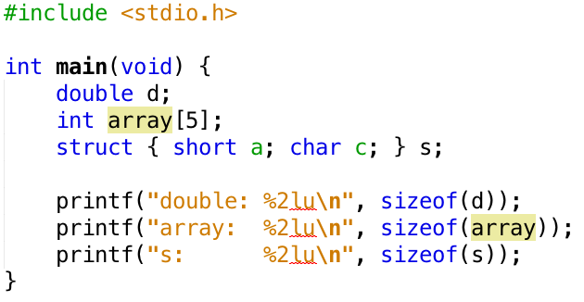
sizeof() operator
Output:
double: 8
array: 20
s: 4
sizeof(type)
Returns number of bytes in object
Number of bits in a byte is not standardized
All modern computers: 8 bits per byte
Some “old” computers use other values, e.g. 6 bits per ”byte”
By definition, in C
sizeof(char)==1
For all other types result is hardware and compiler dependent
Do not assume - Use sizeof!

Slide 20
Agenda
Pointers in C
Arrays in C
This is not on the test
Pointer arithmetic
Strings, main
And in Conclusion, …

Slide 21
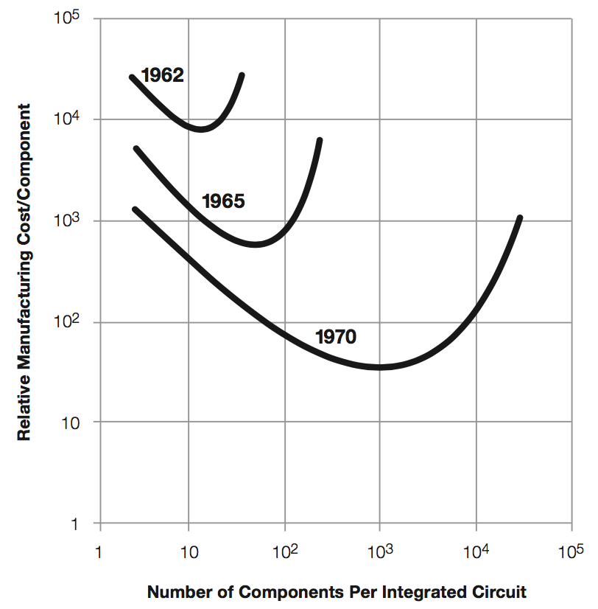
So what did Dr. Moore Predict?
Transistor* cost as a function of components per chip
Minimum
Shifts to right:
As time passes, cost decreases provided we get more
Fortunately we always had good ideas to use more:
Computers
Memory
Smartphones
Internet of Things?
Why a minimum?
If too small, some don’t work!
* Transistors: basic elements making up computers (see later)
Notes:
Horizontal: # components
Vertical: cost per component

Slide 22
Dr. Moore’s Vision (in 1965)
Something useful that is getting always better and less expensive is good for
Society
Business

Slide 23
Why do people say Moore’s Law is over?

Slide 24
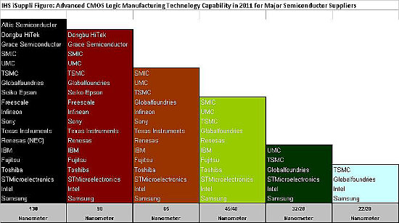
Fabs (where chips are made) $5-10B
Final Four:
Intel
TSMC
Samsung
Global Foundries (was IBM)
130nm
90nm
65nm
40nm
28nm
<=22nm

Slide 25
Break!

Slide 26
Agenda
Pointers in C
Arrays in C
This is not on the test
Pointer arithmetic
Strings, main
And in Conclusion, …

Slide 27
Pointer Arithmetic - char
Type | Name | Byte Addr* | Value
 |  | …
 |  | 108
 |  | 107
 |  | 106
 |  | 105
 |  | 104
 |  | 103
 |  | 102
 |  | 101
 |  | 100
 |  | …
*pc = b
c = 0x7fff50f54b3e
pc = 0x7fff50f54b3f
pc-c = 1
*Computer only uses byte addresses. Tables with blue headers are simplifications.

Slide 28
Pointer Arithmetic - int
Type | Name | Byte Addr | Value
 |  | …
 |  | 108
 |  | 107
 |  | 106
 |  | 105
 |  | 104
 |  | 103
 |  | 102
 |  | 101
 |  | 100
 |  | …
*pi = 20
i = 0x7fff50f54b40
pi = 0x7fff50f54b44
pi-i = 1
Notes:
Each integer uses 4 bytes in memory!
(draw box)

Slide 29
Array Name / Pointer Duality
Array variable is a “pointer” to the first (0th) element
Can use pointers to access array elements
char *pstr and char astr[] are nearly identical declarations
Differ in subtle ways: astr++ is illegal
Consequences:
astr is an array variable, but works like a pointer
astr[0] is the same as *astr
astr[2] is the same as *(astr+2)
Can use pointer arithmetic to access array elements

Slide 30
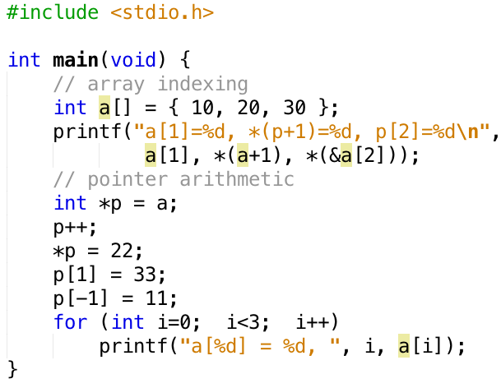
Arrays versus Pointer Example
Type | Name | Addr | Value
 |  | …
 |  | 104
 |  | 103
 |  | 102
 |  | 101
 |  | 100
 |  | …
Output:
a[1]=20, *(p+1)=20, p[2]=30
a[0]=11, a[1]=22, a[2]=33
Mixing pointer and array notation can be confusing → avoid.

Slide 31
Pointer Arithmetic
Example:
int n = 3;
int *p;
p += n; // adds n*sizeof(int) to p
p -= n; // subtracts n*sizeof(int) from p
Use only for arrays. Never:
char *p;
char a, b;
p = &a;
p += 1; // may point to b, or not

Slide 32
Arrays and Pointers
Passing arrays:
Array ≈ pointer to the initial (0th) array element
a[i] ≡ *(a+i)
An array is passed to a function as a pointer
The array size (# of bytes) is lost!
Usually bad style to interchange arrays and pointers
explicitly
pass size
Really int *array
int
foo(int array[],
unsigned int size)
{
… array[size - 1] …
}
int
main(void)
{
int a[10], b[5];
… foo(a, 10)… foo(b, 5) …
}

Slide 33
Arrays and Pointers
int
foo(int array[],
unsigned int size)
{
…
printf(“%d\n”, sizeof(array));
}
int
main(void)
{
int a[10], b[5];
… foo(a, 10)… foo(b, 5) …
printf(“%d\n”, sizeof(a));
}
What does this print?
8
... because array is really
a pointer (and a pointer is architecture-dependent, but likely to be 8 on modern 64-bit machines!)
40
What does this print?
(provided sizeof(int)==4)
Notes:
One difference is that you cannot reassign the name a to point to another object
it that the compiler knows at compile time the size of the array, which {sizeof(int)*10}, which is why it prints 40 for a
(on a computer where sizeof(int) = 4)

Slide 34
Arrays and Pointers
These code sequences have the same effect:
int i;
int array[5];
for (i = 0; i < 5; i++)
{
array[i] = …;
}
Name | Type | Addr | Value
 |  | …
 |  | 106
 |  | 105
 |  | 104
 |  | 103
 |  | 102
 |  | 101
 |  | 100
 |  | …
int *p;
int array[5];
for (p = array; p < &array[5]; p++)
{
*p = …;
}

Slide 35
Point past end of array?
Array size n; want to access from 0 to n-1, but test for exit by comparing to address one element past the array
const int SZ = 10; int ar[SZ], *p, *q, sum = 0; p = &ar[0]; q = &ar[SZ]; while (p != q){ // sum = sum + *p; p = p + 1; sum += *p++;
}
Is this legal?
C defines that one element past end of array must be a valid address, i.e., not cause an error

Slide 36
Valid Pointer Arithmetic
Add/subtract an integer to/from a pointer
Difference of 2 pointers (must both point to elements in same array)
Compare pointers (<, <=, ==, !=, >, >=)
Compare pointer to NULL (indicates that the pointer points to nothing)
Everything makes no sense & is illegal:
adding two pointers
multiplying pointers
subtract pointer from integer

Slide 37
Pointers to Pointers
Notes:
*p = 20

Slide 38
Your Turn …
int x[] = { 2, 4, 6, 8, 10 };
int *p = x;
int **pp = &p;
(*pp)++;
(*(*pp))++;
printf("%d\n", *p);
Name | Type | Addr | Value
 |  | …
 |  | 106
 |  | 105
 |  | 104
 |  | 103
 |  | 102
 |  | 101
 |  | 100
 |  | …
Answer
RED | 2
GREEN | 3
ORANGE | 4
YELLOW | 5

Slide 39
Administrivia
Homework 0 and Mini-bio will be released by tonight
Lab swap policy is posted on Piazza and the website
Guerrilla Session and mini-tutoring session details will be posted soon

Slide 40
Break!

Slide 41
Agenda
Pointers in C
Arrays in C
This is not on the test
Pointer arithmetic
Strings, main
And in Conclusion, …

Slide 42
C Strings
Type | Name | Byte Addr | Value
 |  | …
 |  | 108
 |  | 107
 |  | 106
 |  | 105
 |  | 104
 |  | 103
 |  | 102
 |  | 101
 |  | 100
 |  | …
C strings are null-terminated character arrays
char s[] = ”abc”;

Slide 43
String Example
Output: str = abc, length = 3

Slide 44
Concise strlen()
int strlen(char *s) {
char *p = s;
while (*p++)
; /* Null body of while */
return (p – s – 1);
}
What happens if there is no zero character at end of string?

Slide 45
Arguments in main()
To get arguments to the main function, use:
int main(int argc, char *argv[])
argc is the number of strings on the command line
argv is a pointer to an array containing the arguments as strings

Slide 46
Example
UNIX: $ gcc -o ex Argc.c
$ ./ex -g a "d e f”
arg[0] = ./ex
arg[1] = -g
arg[2] = a
arg[3] = d e f

Slide 47
Agenda
Pointers in C
Arrays in C
This is not on the test
Pointer arithmetic
Strings, main
And in Conclusion, …

Slide 48
And in Conclusion, …
Pointers are “C speak” for machine memory addresses
Pointer variables are held in memory, and pointer values are just numbers that can be manipulated by software
In C, close relationship between array names and pointers
Pointers know the type & size of the object they point to (except void *)
Like most things, pointers can be used for
Pointers are powerful
But, without good planning, a major source of errors
Plenty of examples in the next lecture!

